Slide 1


Domala Venkata Lakshmi Karthik
26-06-24

Slide 2

Outline
Executive Summary
Introduction
Methodology
Results
Conclusion
Appendix

Slide 3
Executive Summary
Summary of methodologies
We strategy used two distinct approaches: online scraping tools and API integration to gather data. We used a variety of Python data manipulation techniques to carefully treat and clean the dataset after the acquisition stage. SQL queries were then utilized to retrieve relevant data from the cleaned dataset. Systematic data visualization and trend analysis produced early insights. After completing our analytical framework, we put supervised machine learning models into practice to forecast the likelihood that landing events will be successful. To forecast if the landing event would be successful, we used supervised machine learning models.
Summary of all results
We were able to find clear patterns and connections between the variables that directly affect landing event success by carefully analyzing the data. By utilizing this information, we were able to create and hone a predictive model that was remarkably effective at predicting the likelihood of a successful landing event. The model's noteworthy accuracy rating of 83% highlights its efficacy in providing dependable prognostications in this particular domain.

Slide 4
Introduction
SpaceX's dedication to reusable rockets has reduced the cost of space travel considerably by carefully concentrating on the first rocket phase's retrieval. Recovering this first stage is critical to maintaining and repurposing costly parts, which directly lowers costs. A thorough examination of the success rate of these retrieval events provides an important indicator for assessing the effectiveness and affordability of SpaceX's innovative strategy. The goal of this specific research is to forecast the first phase retrieval event's success, providing predictive insights that will improve space industry decision-making.
Predicting the first-phase rocket retrieval's success is our goal, with the ultimate goal being resource allocation optimization. We want to improve mission success rates and make significant cost savings by obtaining this predictive capability.

Slide 5

Section 1

Slide 6
Methodology
Executive Summary
Data collection methodology:
Describe how data was collected
Perform data wrangling
Describe how data was processed
Perform exploratory data analysis (EDA) using visualization and SQL
Perform interactive visual analytics using Folium and Plotly Dash
Perform predictive analysis using classification models
How to build, tune, evaluate classification models

Slide 7
Data Collection
Describe how data sets were collected.
The SpaceX launch data was collected using SpaceX API ( REST API) by making a get request to the SpaceX API. This was done in several steps like, first defining a series of helper functions that would be useful to extract information using identification number in the launch data and then requesting rocket launch data from the SpaceX API url.
Finally we will get JSON result, so to make the requested JSON results more consistent, the SpaceX launch data was requested and parsed using the GET request and then decoded the response content as a Json result which was then converted into a Pandas data frame.
Also performed web scraping to collect Falcon 9 historical launch records from a Wikipedia page titled List of Falcon 9 and Falcon Heavy launches of the launch records are stored in a HTML. Using BeautifulSoup and request Libraries, I extract the Falcon 9 launch HTML table records from the Wikipedia page, Parsed the table and converted it into a Pandas DataFrame.

Slide 8
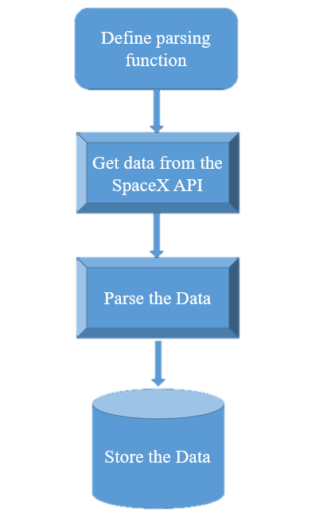
Data Collection – SpaceX API
1) Define auxiliary function to parse the data.
2) Retrieve data from the REST API using the method GET.
3) Parse the data with the previously built auxiliary functions.
4) Store the data in PANDAS DataFrame.
GitHub URL of the completed SpaceX API calls notebook:
Click Here

Slide 9
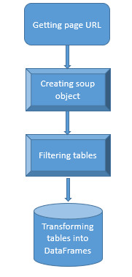
Data Collection - Scraping
1) Using the get request.get method to download page code.
2) Created a BeautifulSoup object to manipulate the html text.
3) Filtered the desired tables using soup manipulation methods.
4) Converted the data from the HTML to pandas DataFrame format.
GitHub URL of the completed web scraping notebook:
Jupyter Lab Webscraping

Slide 10
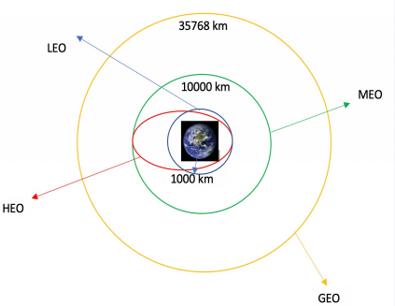
Data Wrangling
We identified the training labels by doing an exploratory data analysis.
We determined the quantity of launches at every location as well as the frequency of each orbit.
From the outcome column, we generated a landing outcome label and exported the data to CSV.
Github Notebook file data wrangling
Click Here

Slide 11
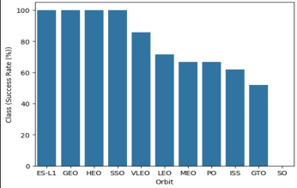
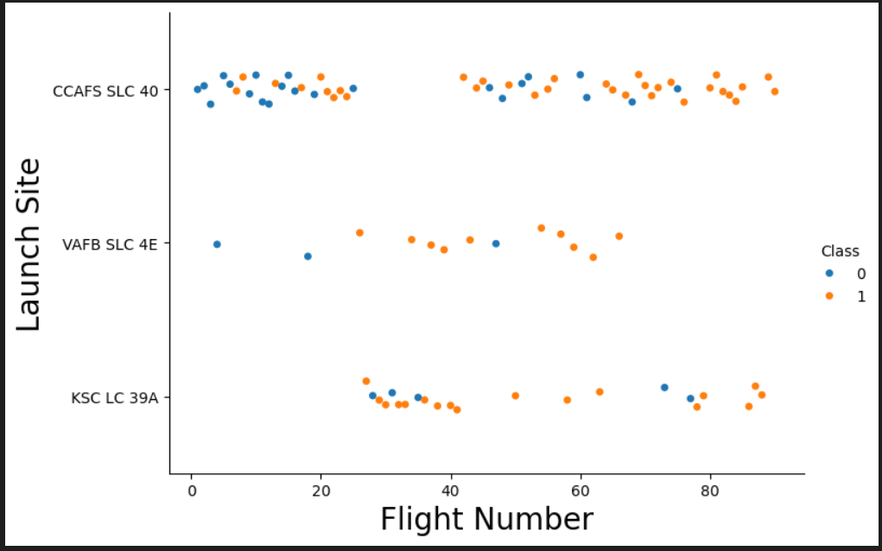
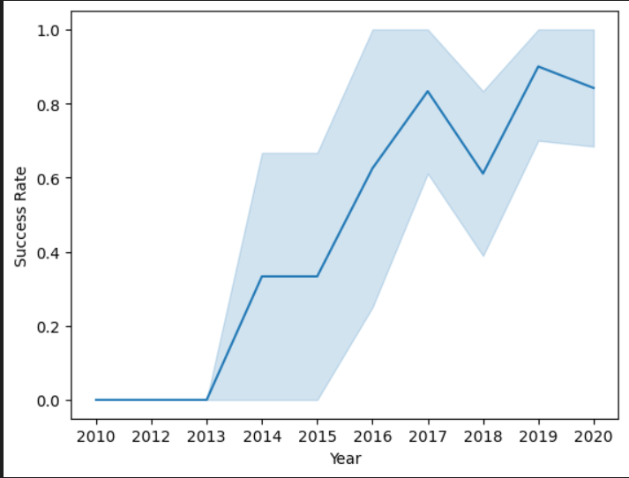
EDA with Data Visualization
We have explored the data using EDA – Exploratory data analysis with data visualization and fount out the relation between flight number and launch site, payload and launch site, Success rate of each orbit type, flight number and orbit type, payload and orbit type, launch success yearly trend.
For Github Notebook File Click Here

Slide 12
EDA with SQL
Using SQL, we had performed many queries to get better understanding of the dataset.
Displaying the names of the launch sites.
Displaying 5 records where launch sites begin with the string ‘CCA’.
Displaying the total payload mass carried by booster launched by NASA (CRS).
Displaying the average payload mass carried by booster version F9 v1.1.
Listing the date when the first successful landing outcome in ground pad was achieved.
Listing the names of the boosters which have success in drone ship and have payload mass greater than 4000 but less than 6000.
Listing the total number of successful and failure mission outcomes.
Listing the names of the booster_versions which have carried the maximum payload mass.
Rank the count of landing outcomes (such as Failure (drone ship) or Success (ground pad)) between the date 2010-06-04 and 2017-03-20, in descending order.
For Github Link Click Here

Slide 13
Build an Interactive Map with Folium
On the folium map, we annotated every launch point and added map elements like circles, lines, and markers to indicate the success or failure of launches at each location.
Class 0 and Class 1 were given the feature launch outcomes (success or failure).i.e., 1 for accomplishment and 0 for failure.
It was possible to determine which launch sites have a comparatively high success rate by using the color-labeled marker clusters.
We calculated the distances between a launch site to its proximities. We
answered some question for instance:
Are launch sites near railways, highways and coastlines.
Do launch sites keep certain distance away from cities.
For Github link Click Here

Slide 14
Build a Dashboard with Plotly Dash
We built an interactive dashboard with Plotly dash.
We plotted pie charts showing the total launches by a certain sites.
We plotted scatter graph showing the relationship with Outcome and
PayloadMass (Kg) for the different booster version.
For Github Notebook Click Here

Slide 15
Predictive Analysis (Classification)
We loaded the data using numpy and pandas, transformed the
data, split our data into training and testing.
We built different machine learning models and tune different
hyperparameters using GridSearchCV.
We used accuracy as the metric for our model, improved the model using feature engineering and algorithm tuning.
We found the best performing classification model.
For Github Notebook Click Here

Slide 16
Results
Exploratory data analysis results
Interactive analytics demo in screenshots
Predictive analysis results

Slide 17

Section 2

Slide 18
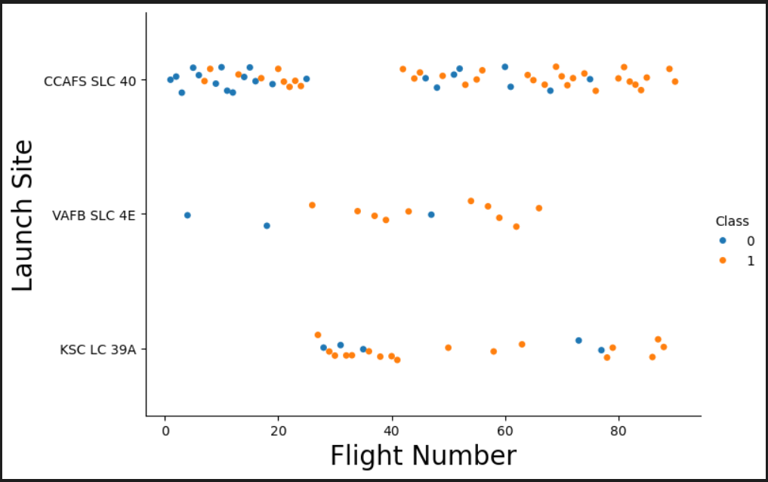
Flight Number vs. Launch Site
We deduced from the plot that a launch site's success rate increased with the number of flights conducted there.

Slide 19
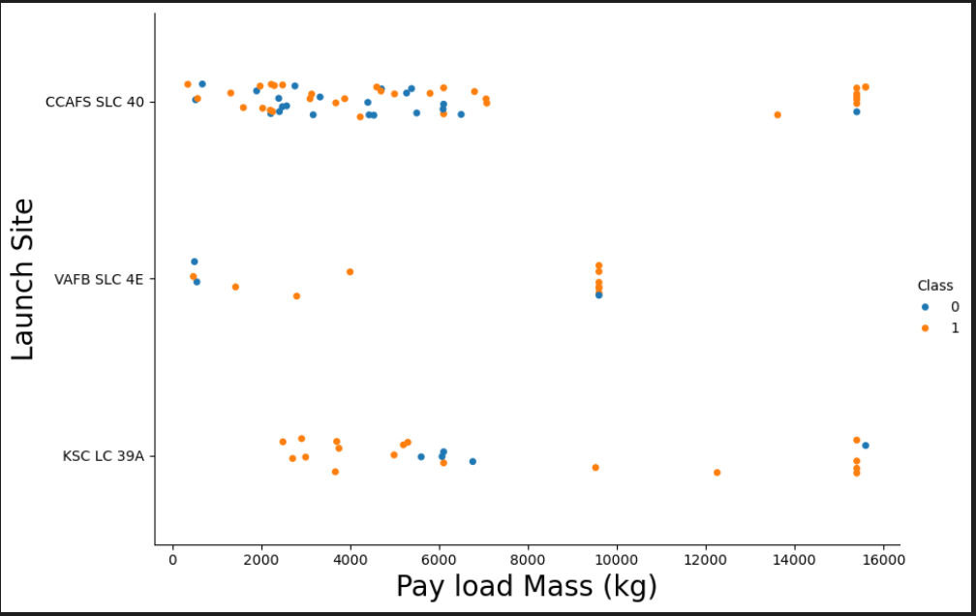
Payload vs. Launch Site
The higher the rocket's success percentage, the larger the payload mass at launch point CCAFS SLC 40.

Slide 20
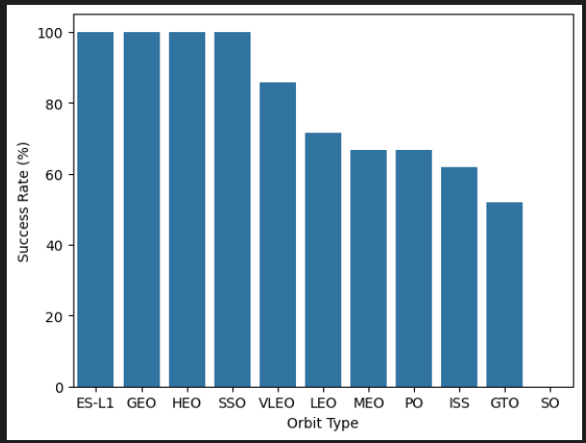
Success Rate vs. Orbit Type
From the plot, we can see that ES-L1, GEO, HEO, SSO, VLEO had the most success rate.

Slide 21
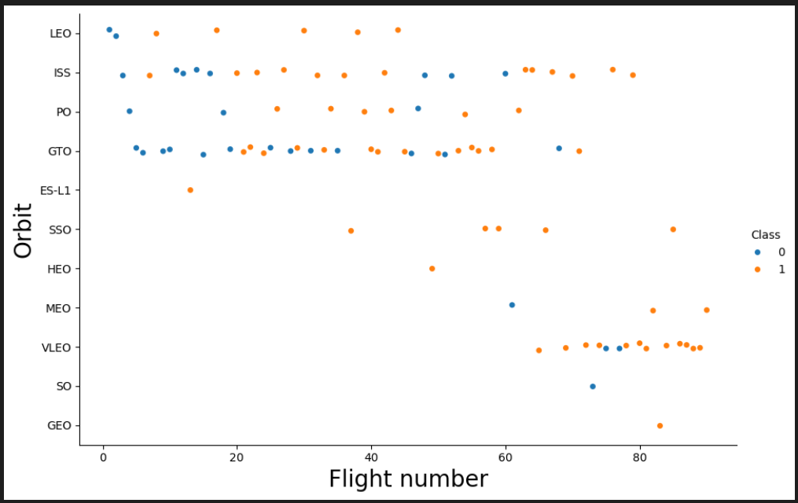
Flight Number vs. Orbit Type
The Flight Number versus Orbit type is displayed in the plot below. We note that while there is no correlation between trip number and orbit in the GTO orbit, there is in the LEO orbit where success is correlated with the number of flights.

Slide 22
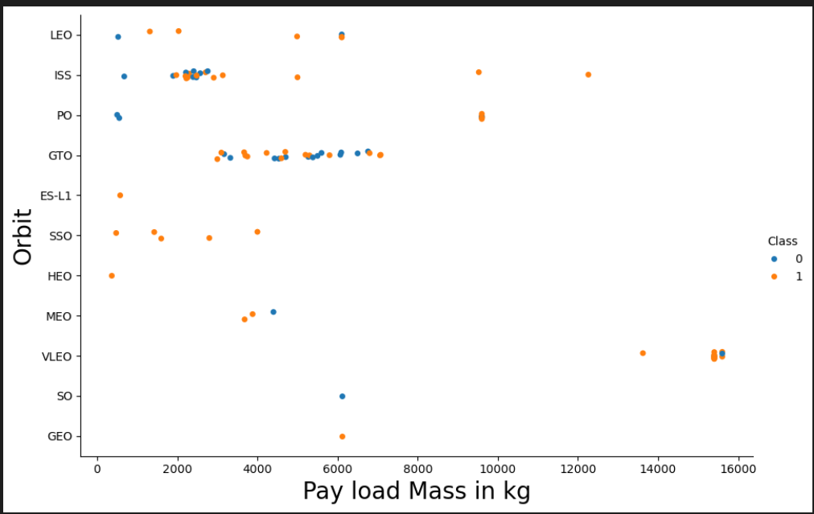
Payload vs. Orbit Type
We can observe that with heavy payloads, the successful landing are more for PO,LEO and ISS orbits.

Slide 23
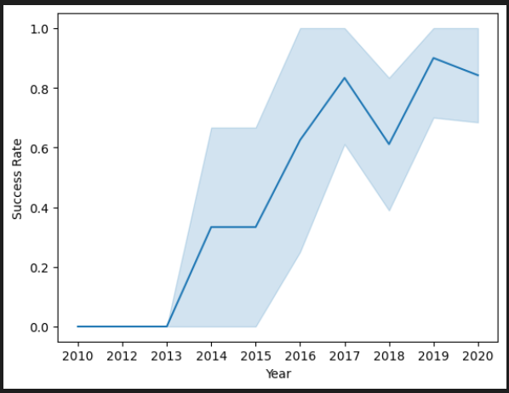
Launch Success Yearly Trend
From the plot, we can observe that success rate since 2013 kept on increasing till 2020.

Slide 24
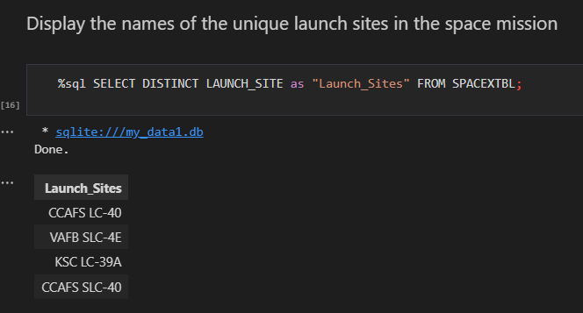
All Launch Site Names
We used the key word DISTINCT to show only unique launch sites from the SpaceX data.

Slide 25
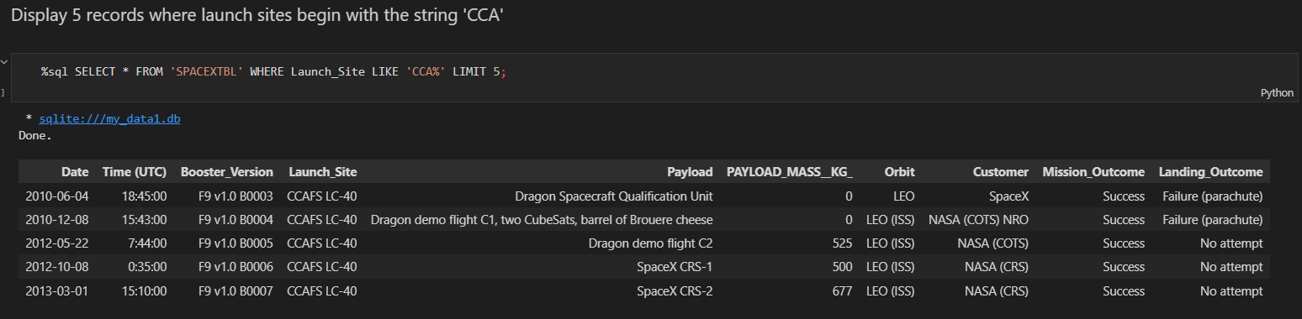
Launch Site Names Begin with 'CCA'
We used the query above to display 5 records where launch sites begin with CCA.

Slide 26
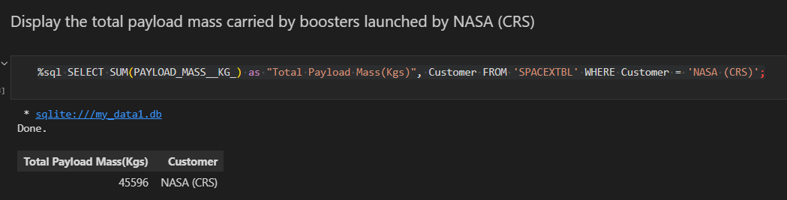
Total Payload Mass
We calculated the total payload carried by boosters from NASA as 45596 using the query below
%sql SELECT SUM(PAYLOAD_MASS__KG_) as "Total Payload Mass(Kgs)", Customer FROM 'SPACEXTBL' WHERE Customer = 'NASA (CRS)';

Slide 27
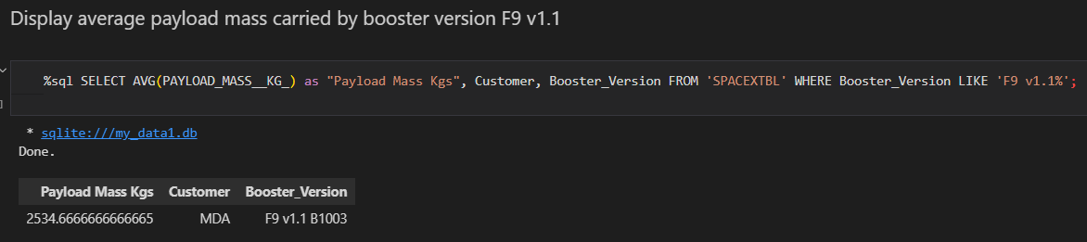
Average Payload Mass by F9 v1.1
We calculated the average payload mass carried by booster version F9 v1.1 B1003 as 2534.66666666666.

Slide 28
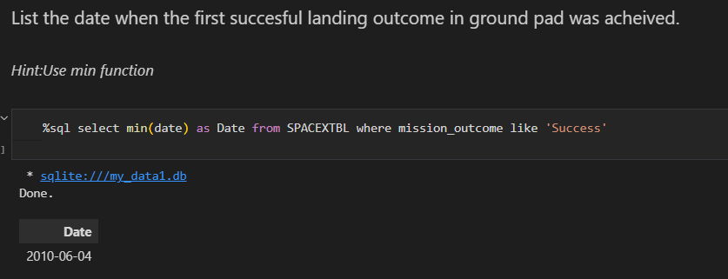
First Successful Ground Landing Date
Find the dates of the first successful landing outcome on ground pad

Slide 29
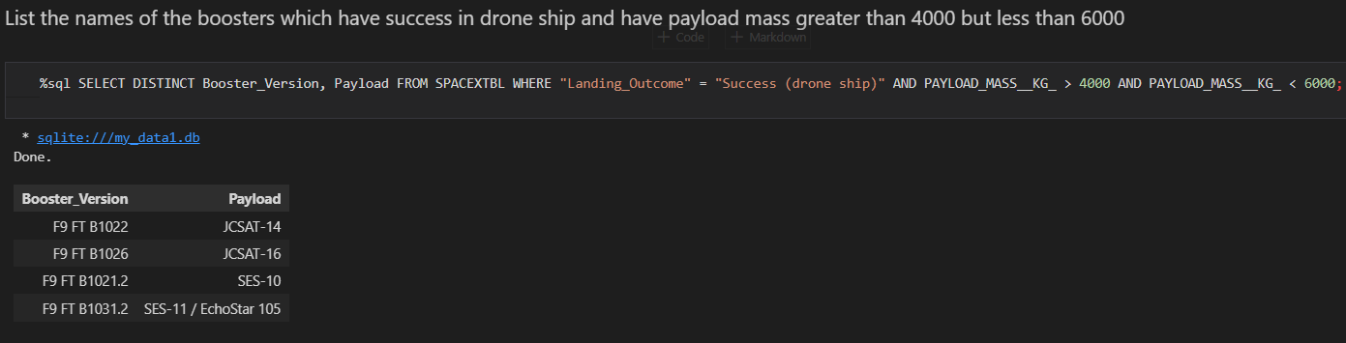
Successful Drone Ship Landing with Payload between 4000 and 6000
We used the WHERE clause to filter for boosters which have success fully landed on drone-ship and applied the and condition to determine successful landing with payload mass greater than 4000 but less than 6000.

Slide 30
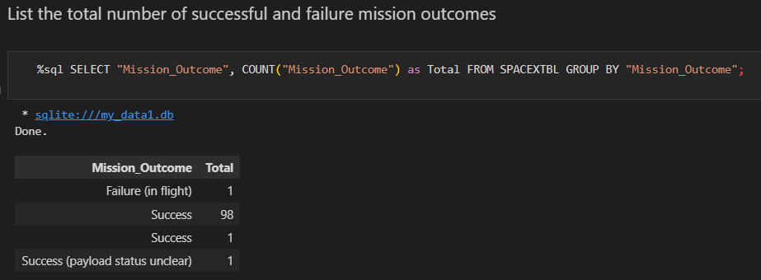
Total Number of Successful and Failure Mission Outcomes
Total Number of failure mission outcome are 1 and
Total number of success mission outcomes are 100

Slide 31
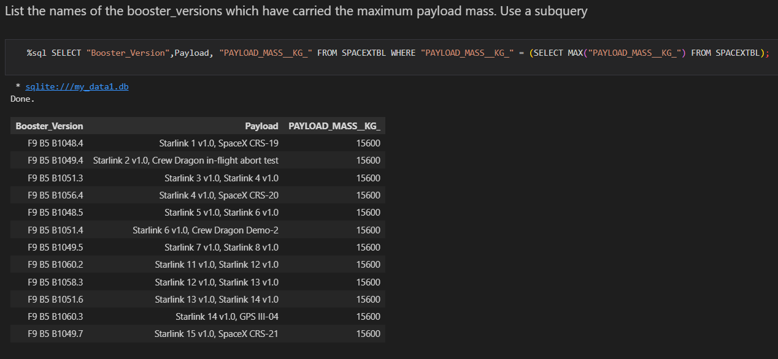
Boosters Carried Maximum Payload
We determined the booster that have carried the maximum payload using a subquery in the WHERE clause and the MAX() function.

Slide 32
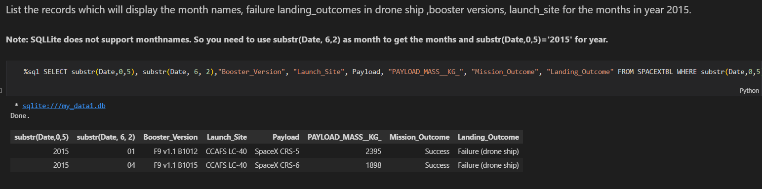
2015 Launch Records
We used a combinations of the WHERE clause, LIKE, AND, and Between conditions to filter for failed landing outcomes in drone ship, their booster versions, and launch site names for year 2015.

Slide 33
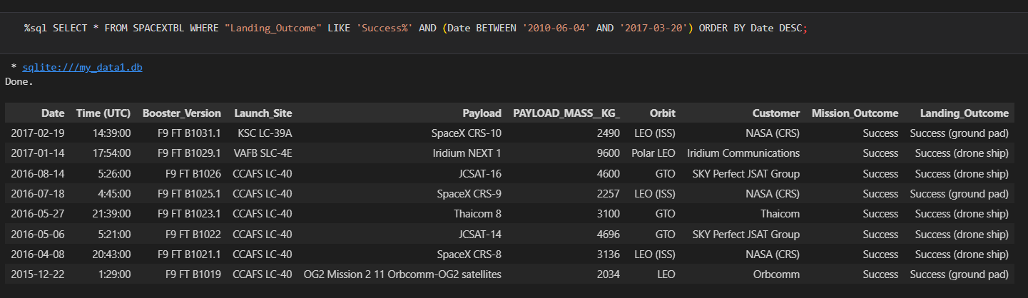
Rank Landing Outcomes Between 2010-06-04 and 2017-03-20
Rank the count of landing outcomes (such as Failure (drone ship) or Success (ground pad)) between the date 2010-06-04 and 2017-03-20, in descending order

Slide 34

Section 3

Slide 35
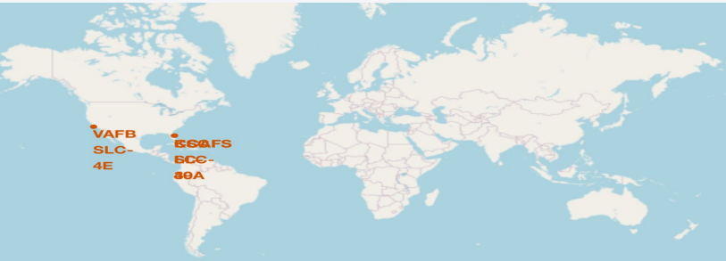
All Launch sites global map markers
We can see that the Space launch sites are in the United States of America coasts. Florida and California

Slide 36
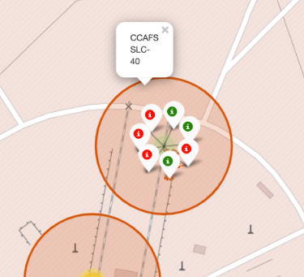
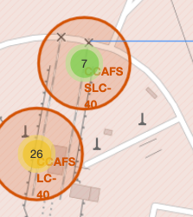
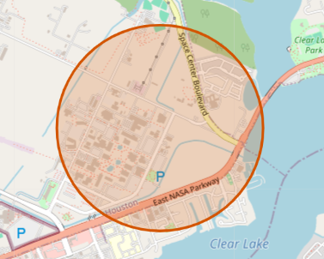
Markers showing launch sites with color lables
Green marker -> successful launches.
Red marker showing unsuccessful launches,

Slide 37
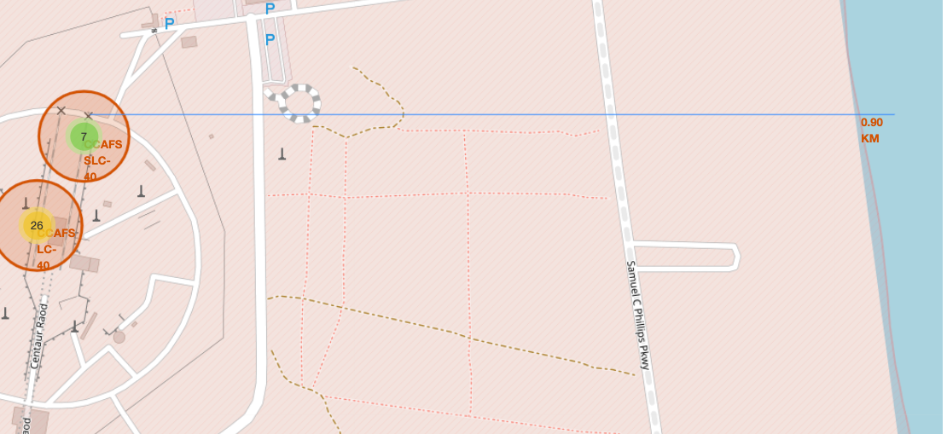
Launch sites distance to landmarks

Slide 38

Section 4

Slide 39
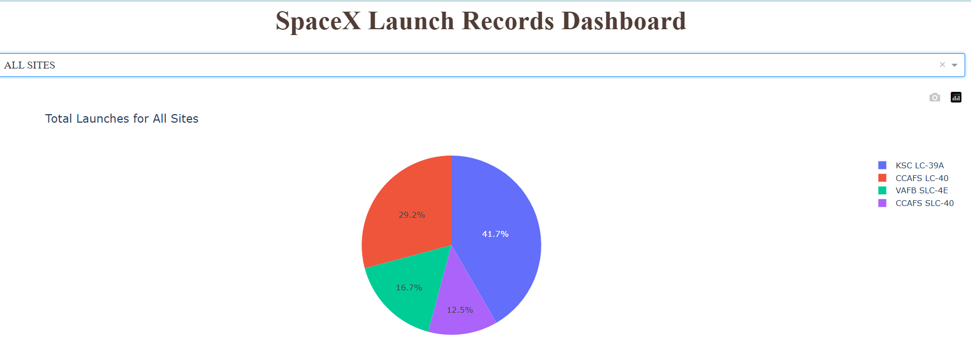
Pie chart showing the success percentage achieved by each launch site
We can see that KSC LC-39A had the most successful launches from all the sities

Slide 40
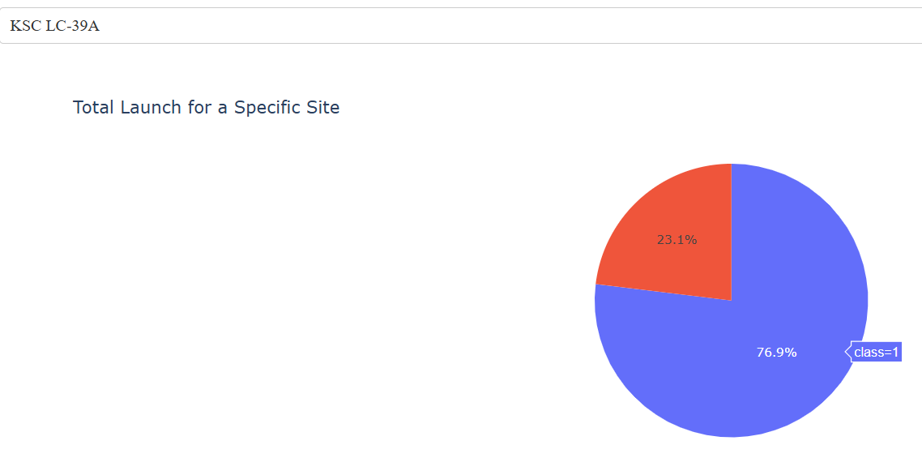
Pie chart showing the launch site with the highest launches success ratio
KSC LC-39A achieved a 76.9% success rate while getting a 23.1% failure rate

Slide 41
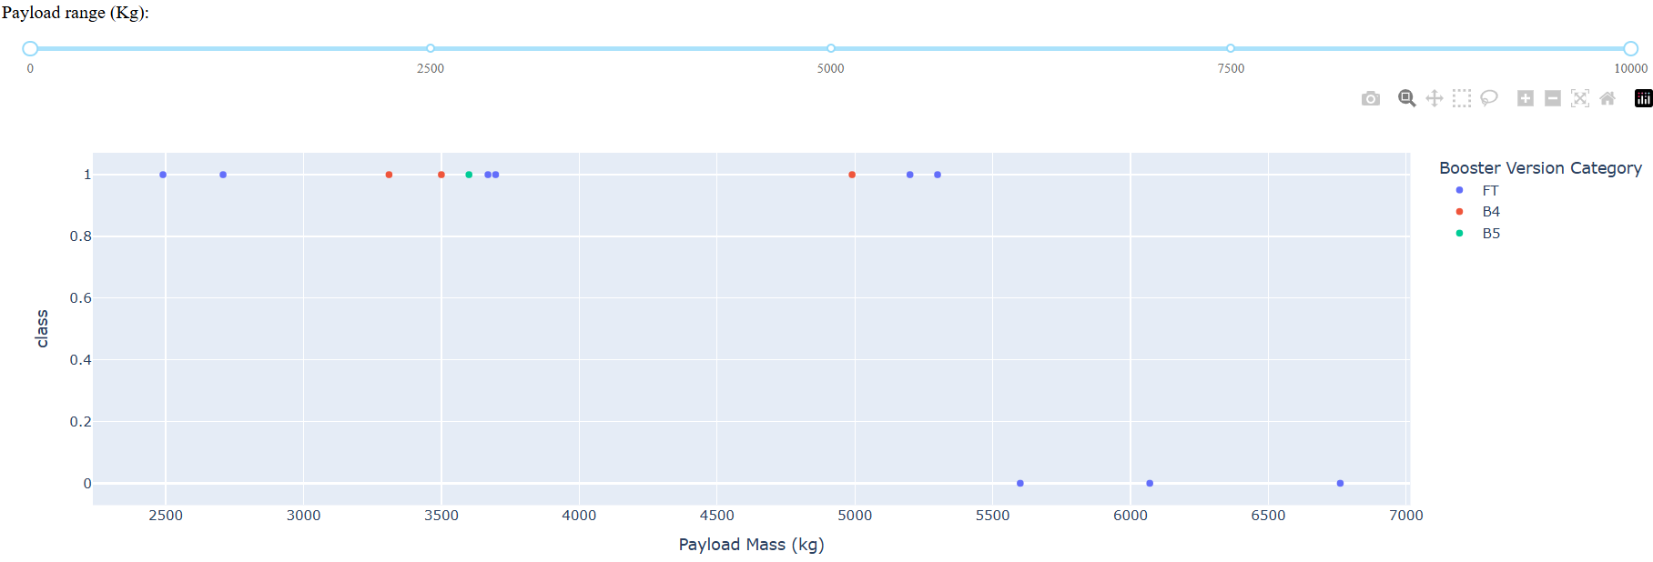
Scatter plot of the payload vs launch outcome for all sites, with different payload selected int the range slider
We can see the success rates for low weighted payloads is higher than the heavy weighted payloads.

Slide 42

Section 5

Slide 43
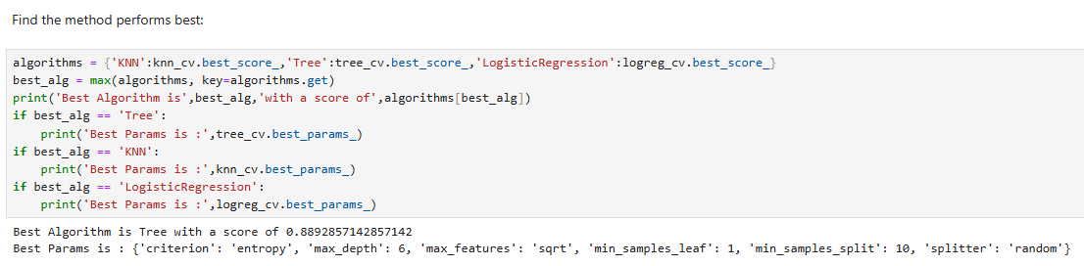
Classification Accuracy
The decision tree classifier is the model with the highest classification accuracy

Slide 44
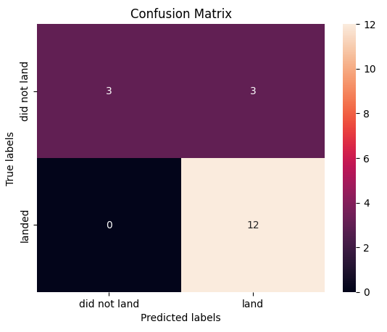
Confusion Matrix
The confusion matrix for the decision tree classifier shows that the classifier can distinguish between the different classes.The major problem is the false positives .i.e.,unsuccessful landing marked as successful landing by the classifier.

Slide 45
Conclusions
We can conclude that:
The larger the flight amount at a launch site, the greater the success rate at a launch site.
Launch success rate started to increase in 2013 till 2020. Orbits ES-L1, GEO, HEO, SSO, VLEO had the most success rate.
KSC LC-39A had the most successful launches of any sites.
The Decision tree classifier is the best machine learning algorithm for this task.

Slide 46
Appendix
Include any relevant assets like Python code snippets, SQL queries, charts, Notebook outputs, or data sets that you may have created during this project
Github Link Click Here

Slide 47


